Slide 1
Economics of Nurse Practitioners
Economic Impact of the Expansion of Nurse Practitioner Score of Practice for Medicaid

Slide 2
Primary Care Shortage
Healthcare in the United States is increasingly expensive
The demand for primary care continues to rise
Supply of quality primary care strains to keep pace
Underserved populations are facing the brunt of the primary care shortage
  This includes vulnerable groups like those living rural areas and those on Medicaid
Increasing the number of NPs and their scope of practice is a possible component of solving the primary care shortage
Notes:
Seeing the current expenses of healthcare in the United States there is a large concern over how to control costs in the future. This demand for all care, especially primary care continues to rise while the supply of quality primary care practitioners struggles to keep pace. The populations that are hurting the most with this shortage are underserved populations, especially those on Medicaid. Increasing the scope of practice for NPs is a potential solution to this problem, but this requires continued research and lobbying to implement.

Slide 3
NP Practice Environment
Scope of Practice for NPs varies a great deal across the country
  23 states let NPs practice with autonomy
  The rest of the states require supervision or collaboration with a physician
There are calls to both expand and restrict NP autonomy
  National Academy of Medicine supports the expansion of NP practice
  American Academy of Physicians recommends continued restriction and supervision of NPs
Notes:
Currently 23 states allow NPs to practice to the full scope, but the other require NPs to work with physicians with some type of collaboration or supervision. There is currently opposite lobbying in most states regarding scope of practice for NPs. Physician groups encourage NP oversight while nursing organizations support increasing NP scope of practice.

Slide 4
Arguments for Increased NP Autonomy
Reducing regulations on NP scope of practice improves supply of primary care providers
NPs increase access to quality care for those on Medicaid
Studies have shown the potential for increased NP autonomy to result in decreased healthcare costs
Other studies have shown no increase in healthcare costs associated with increased NP autonomy
Notes:
Nurse lobbying organizations provide strong arguments for increased autonomy. These arguments center around increasing access to care while decreasing cost of care. In our current healthcare environment in the US this is an especially strong argument.

Slide 5
Arguments Against NP Autonomy
One concern is the cost of care due to over utilization of medications by patients being cared for by NPs
  This has likely not been directly studied
Over utilization of medications is especially important in our current opioid crisis
Increasing NP scope of practice may actually decrease patient access to care
  There have not been many national studies to examine this relationship
Notes:
Physician organizations argue against increasing NP SOP by also addressing the cost implications of this. The arguments from physician organizations centers on the over-utilization of medications by NPs which is incredibly important when taking into account the current opioid crisis in the country. There have also been studies conducted showing potential decreases in access to care after increases in NP SOP. These studies have not been conducted on a national level.-

Slide 6
Research findings
Patients in states implementing full practice authority for NPs saw increases in Medicaid patient care without increasing costs
  As Poghosyan et al. state “each dollar spent on Medicaid provides more care to patients.”
States with full scope of practice for NPs had 17.4% lower outpatient costs than those with restricted practice
Medicaid patients have seen more available primary care appointments in states with full NP practice authority
  No difference was seen when increasing the number Physician Assistants working in primary care
Notes:
Research findings suggest that patients, especially Medicaid patients, benefit from increased NP SOP. These benefits are the result of increased access to care without increasing the cost of care. Increasing the number of PAs working in primary care does not show the same results, suggesting that the increased SOP of practice is the element responsible the for changes.

Slide 7
Future of NPs
Expanding the scope of practice for NPs in the future is a research supported method of improving access to primary care for patients on Medicaid
  As Pogohsyan et al stated those in legislatures must, “examine all intended and unintended effects of regulatory actions.” Meaning they should not minimize the findings supporting increased NP SOP.
Number of trained NPs expected to nearly double from 2013 to 2025 providing a large workforce to draw from in the future.
Notes:
In the future NPs will likely be a great asset in the solution for decreasing the cost of care, especially to vulnerable populations like those on Medicaid. Legislative leaders must consider studies like these while deciding the best methods for increasing access to care among their constituents. The number of available NPs continues to improve as well providing additional assets to utilize when and if NP SOP is expanded.

Slide 8
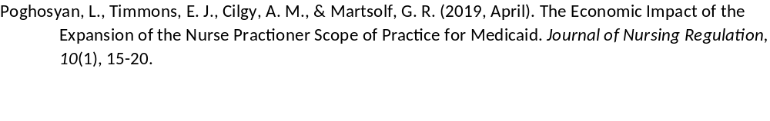
Works Cited

